Slide 1

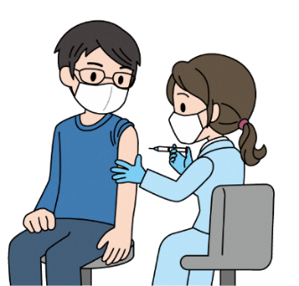
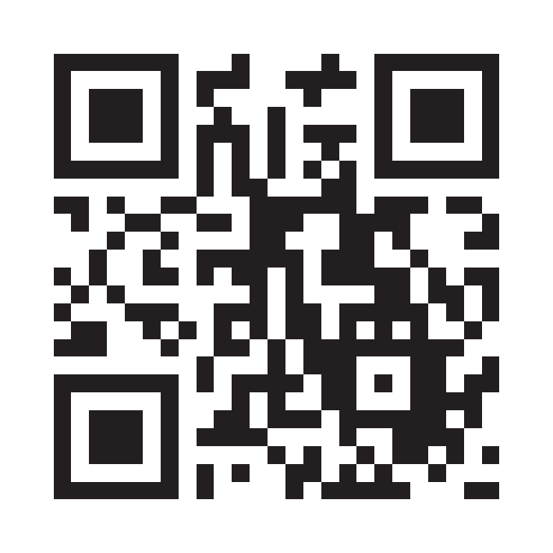
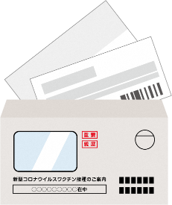
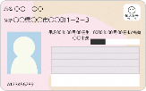
追加接種のお知らせ（英語）
Name of local municipality
Mach 08, 2022
Notice on COVID-19 booster shots
(3rd dose)
Process leading to vaccination
1
Your vaccination voucher arrives
When your vaccination voucher has arrived, you can receive the vaccine.
*The start date for taking reservations for booster shots will vary depending on your local municipality.
*You must be 18 years of age or older at the time of vaccination.
2
Find a medical institution or vaccination site
Check your local municipal newsletter or online to find medical facilities and vaccination sites where you can receive the vaccine. Medical workers may be able to receive the vaccination at the medical institution where they work.
For more details, check with your workplace.
Comprehensive vaccination information website
COVID-19 Vaccine Navi
https://v-sys.mhlw.go.jp
*If you are unable to find a medical institution or vaccination site, you can also ask your local municipality.
*Except for those who are hospitalized or resident at a facility, in principle, you will receive a vaccine at the municipality (registered address) listed on your certificate of residence.
Please see the reverse side for information about vaccinations outside of your area of residence (registered address).
*It is not possible to make reservations directly through COVID-19 Vaccine Navi.
3
Make an appointment,
and get the vaccine
Vaccine cost
Free of charge
(publicly funded)
Contact your local municipality or a medical institution that accepts appointments.
Vaccination site in local municipality
^{Call Center:} 0000-0000-0000
Designated medical institution in your area
Make an appointment directly at a medical institution
(by phone, online, etc.)
Set of contents in envelope
What to bring
^{on the day}
・The set of contents inside the envelope that held this notice
・Identification documents (Individual Number Card,
Driver‘s license, Health insurance card, Residence Card etc.)
＋
Individual Number Card, etc.
*Inside the envelope, you will find a preliminary examination form with a vaccination voucher printed on it, as well as a certificate of vaccination. Please keep these in a safe place, and be sure not to lose them.
(Some vaccination vouchers are combined with vaccination certificates as an all-in-one document.)
*Please measure your body temperature at home prior to vaccination. If you clearly have a fever or feel unwell, etc. please refrain from getting vaccinated and contact the municipal office or medical institution where you made your appointment.
*Be sure to wear clothing that allows you to bare your shoulder easily during the vaccination process.

Slide 2
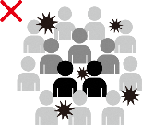
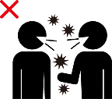
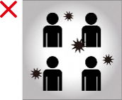


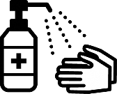
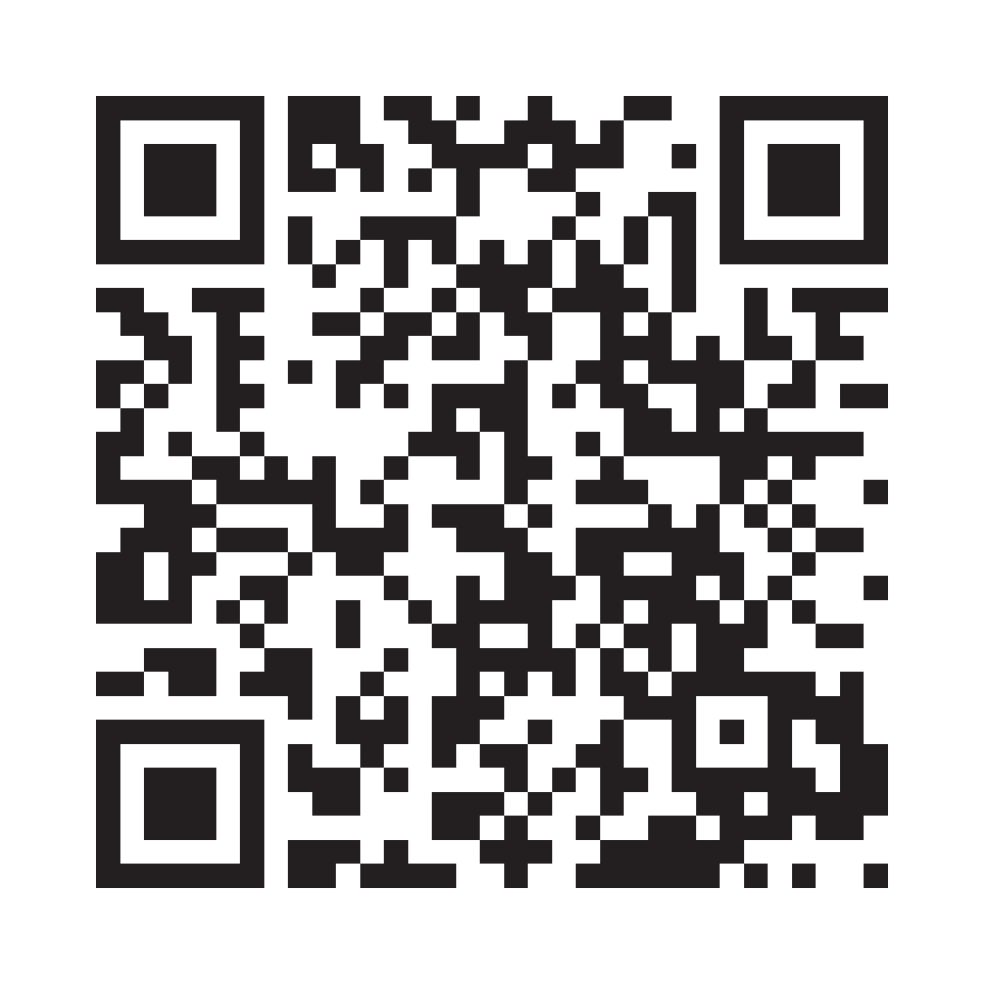
◎ People for whom booster vaccination is recommended
・Those at high risk of developing serious illness, such as the elderly and anyone with an underlying medical condition
・Those who have frequent contact with anyone at high risk of developing serious illness, such as anyone related to or assisting people at high risk of serious illness (e.g., care workers)
・Those who are at high risk of exposure to the virus for occupational reasons, such as medical personnel
◎ Vaccinations outside of your area of residence (registered address)
・If you are receiving the vaccine at a medical institution or similar facility while hospitalized or resident at a facility ➡ Please consult with the medical institution.
・If you are receiving the vaccine at a medical institution where you are being treated for an underlying medical condition ➡ Please consult with the medical institution.
・If your residence is different from your registered address ➡ You may be able to receive the vaccine in the area where you actually live.
Please check the website of the municipality where you actually live or contact its consulting service.
◎ In the event that you suffer some injury to your health due to vaccination, a relief system is available.
Vaccinations can cause health problems (including illness or disability). Although this is extremely rare, the risk cannot be eliminated, and a relief system has been established for this reason.
Please consult with the municipality where you reside in regard to the procedures required for application.
◎ Your consent is required to receive the vaccine.
Before receiving the vaccine, please make sure that you have a correct understanding of both the efficacy of the vaccine in preventing infectious diseases and the risk of an adverse reaction, and then decide whether or not to be vaccinated at your own discretion. Vaccinations will not be administered without the consent of the recipient.
Vaccinations must not be forced on anyone in the workplace or others around you, nor should unvaccinated persons be discriminated against.
◎ After receiving the vaccine, please continue to take measures to prevent infection, such as wearing a mask.
COVID-19 vaccines have been shown to be highly effective in preventing the onset of COVID-19, but they are not 100% effective. Also, mutations of the virus can also have an impact.
For this reason, we ask that everyone continue to take measures to prevent infection. Specifically, please avoid the "three Cs" (crowded places, close contact settings, closed spaces), wear a mask, wash your hands with soap, encourage disinfecting with alcohol-based hand sanitizer, and so on.
Please continue to take preventive measures against infection.
Crowded places Close contact settings Closed spaces
Avoid the "three Cs" (crowded places, close contact settings, closed spaces)
Wear a mask
Wash hands with soap
Encourage disinfecting with alcohol-based hand sanitizer
For more information on the efficacy and safety of COVID-19 vaccines, please refer to the "COVID-19 Vaccines" page on the website of the Ministry of Health, Labour and Welfare (MHWL).
MHWL COVID-19 vaccine Search
If you are unable to view the website, please contact your local municipality.
Inquiries

