Slide 1
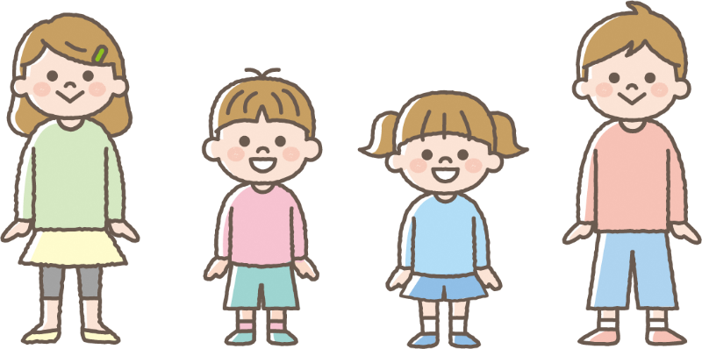
英語
February 10, 2022
For Children Aged 5 to 11 & Their Parents or Guardians
About COVID-19 Vaccination
Vaccination
Cost
Free of Charge
(Fully Government
-Subsidized)
Children ages 5 and older
are also eligible to receive COVID-19 vaccination.
Please read this informational pamphlet and talk about getting vaccinated with your family.
Please bring your Maternal and Child Health Handbook with you on the day you get vaccinated.

Slide 2
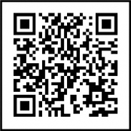
Dear Parents and Guardians,
Children ages 5 to 11 are now eligible to receive COVID-19 vaccinations. The number of children accounting for COVID-19 infections has risen nationwide.
Please read this informational pamphlet and discuss whether or not to vaccinate your child.
◎ About the Vaccine
Child vaccinations use the Pfizer COVID-19 vaccine made for children ages 5 to 11*.
Normally, vaccines are given in 2 doses with a 3 week interval between the 1st and 2nd dose.
*This vaccine contains 1/3 the active components compared with the Pfizer COVID-19 vaccine for those ages 12 and older.
◎ Who is the Vaccine for?
●Children ages 5 to 11
●This vaccine is especially recommended for children with underlying medical conditions such as chronic
respiratory conditions, congenital heart defects, and other diseases for which there is
a high risk of developing severe COVID-19 symptoms*. Please consult your pediatrician
before having your child vaccinated.
*The Japan Pediatric Society has released a list of conditions that can lead to severe symptoms
in the event of being infected with COVID-19. For more information, please access the following link
(Japan Pediatric Society): https://www.jpeds.or.jp/modules/activity/index.php?content_id=333 (Japanese only)
About the Effects of the COVID-19 Vaccine
Q. What effects does the COVID-19 vaccine have?
Receiving the COVID-19 vaccine will make it so that, even if someone is infected with COVID-19, it is less likely they will exhibit symptoms of the virus.
When the body receives a COVID-19 vaccination, it can produce mechanisms (i.e., gain immunity) that will combat the virus inside the body. This makes the body ready to fight the virus as soon as it enters the body, which makes it less likely that the person will exhibit symptoms of COVID-19. Reports show that children ages 5 to 11 exhibit 90.7%* efficacy in preventing symptoms from the 7th day after receiving their 2nd dose of the vaccine.
*This data was produced before the advent of the Omicron variant.
Source: Reports concerning Specially Approved Pharmaceuticals
About Vaccine Safety
Q. What kinds of side-effects can I expect my child to have after he or she gets the COVID-19 vaccine?
A. The most common side-effect you can expect is for the area where the injection was made to hurt.
The main side-effect children experienced in the days after receiving vaccines was discomfort at the area the injection took place. 74% of children experienced discomfort after the 1st dose and 71% after the 2nd. Many people report feeling pain starting in the evening of the day they were injected or from the following day. Some people experienced fatigue or ran fevers, with the majority experiencing these symptoms after the 2nd dose as opposed to the 1st. 2.5% of vaccine recipients ran a fever of 38℃ (100.4℉) after the first dose and 6.5% after the 2nd. Most side-effects of the vaccine range from mild to moderate. According to current data, experts have determined there is no cause for concern in terms of severe problems developing as a result of vaccination.
Side-Effects That Can Develop Days After Injection
Percentage of People who
Experienced Side-Effects
Side-Effect
Over 50%
10 ~ 50%
1 ~ 10%
Pain in the area of injection, general fatigue
Headache, redness/swelling in the area of injection, muscular pain, feeling chills
Diarrhea, fever, joint pain, vomiting
Source: Reports concerning Specially Approved Pharmaceuticals
Q. I heard that the younger the boy is, the more likely he is to experience myocarditis after being
vaccinated. Is this true for young children also?
According to data from the United States, boys between 5 and 11 years are less likely to develop myocarditis than those between 12 and 17.
While cases are extremely rare, there have been reports in countries outside Japan where children developed mild cases of myocarditis. In the United States, the number of children that reported developing myocarditis after receiving COVID-19 vaccinations was fewer in boys aged 5 to 11 than boys aged 12 to 15 and 16 to 17.
If your child develops symptoms such as chest pain, heart palpitations, shortness of breath, or swelling within 4 days of receiving a vaccination, go see a doctor immediately and inform him or her that the child has recently been vaccinated. In the event that myocarditis is discovered, typically this will mean the child will need to be admitted to the hospital, but in most cases, the child will naturally recover from the condition with enough rest.
Source: ACIP Meeting on Jan. 5, 2022

Slide 3
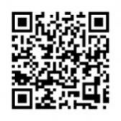
Dear Parents and Guardians,
How Do I Get My Child Vaccinated?
◎ For a child to receive a COVID-19 vaccination, they will require the consent of a parent or guardian, and a parent or guardian must be present during the vaccination process.
Please be sure to have a proper understanding of both aspects of infectious prevention and side-effects before you, the parent or guardian, makes a decision when applying to have your child vaccinated. Please be aware that children cannot receive vaccinations without the consent of a parent or guardian.
Do not engage in trying to force those around you to get vaccinated or discriminating against those who are unvaccinated.
◎ Please try to bring your Maternal and Child Health Handbook on the day of your child’s vaccination.
Child vaccinations are recorded in Maternal and Child Health Handbooks, so if possible, please bring said handbook with you on the day of your child’s vaccination.
Otherwise, please also be sure to bring all the accompanying documents included with this notice as well as a form of ID (e.g., My Number card, health insurance card, etc.).
◎ If you have any questions or reservations about vaccination, please consult your family doctor or pediatrician.
If you have any questions about COVID-19 vaccinations or intervals you should maintain between other vaccinations, please consult your family doctor or pediatrician. As a general rule, COVID-19 vaccinations should not be taken at the same time or within 2 weeks of any other vaccinations. Also, if you have any questions or reservations about vaccinating a child with any underlying medical conditions, please speak with your family doctor or pediatrician.
For Consultations
◎ Consultations Regarding COVID-19 Vaccinations
If your child experiences any physical or physiological abnormalities after being vaccinated
Contact the medical institution where the vaccine was administered, your family doctor/pediatrician, or municipal or prefectural COVID-19 information centers
For general questions about COVID-19 vaccinations
Contact your municipal COVID-19 information center
◎ About Relief Systems for Injuries Sustained from Vaccinations
It is possible for persons to experience damage to health arising from vaccinations (e.g., becoming sick, lasting disorders arising, etc.). While instances of these issues are extremely rare, they can occur, and thus relief systems have been established to address them.
In the event that damages to a person’s health arise from receiving a COVID-19 vaccine, that person can receive relief (e.g., benefits covering medial expenses, disability pensions, etc.) in accordance with the Preventive Vaccination Law*. For information on how to apply for said relief, please contact your local municipal office/city hall that issues your resident card.
*In the event that the Minister of Health, Labour and Welfare recognizes said health damages as a result of vaccination, benefits will be issued on the part of your local municipality. Said recognition will be made via a review of causality by a national review board for illnesses and disabilities made up of experts in the fields of vaccination, infectious diseases, medicine, and law.
Some people choose to get vaccinated, and some people choose not to. Even after you have been vaccinated, be sure to continue take precautions against infection as you have, up to now, by regularly washing and disinfecting your hands and wearing a mask.
Avoid CROWDED PLACES
Avoid CLOSE-CONTACT settings
Avoid CLOSED SPACES with poor ventilation
Wear a mask
Wash your hands with soap and water
Disinfect your hands
For more details on the safety and effectiveness of COVID-19 vaccines for children, please go to the Ministry of Health, Labour and Welfare’s official website.
MHLW COVID-19 Vaccine Children Search
If you cannot access the Ministry of Health, Labour and Welfare’s official website, please contact your local municipality or city hall.

Slide 4
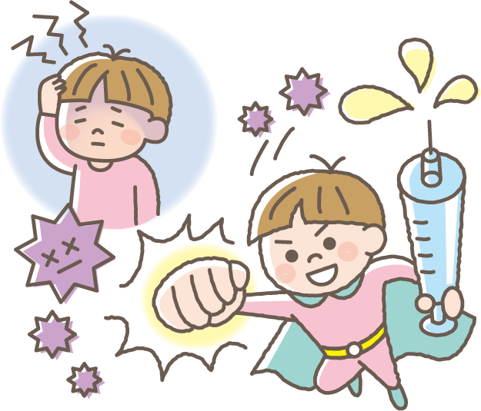
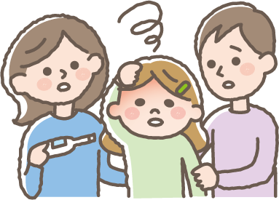
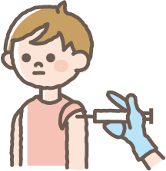
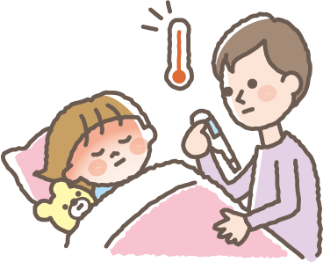
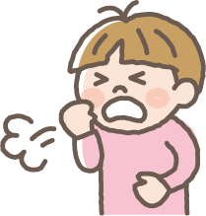
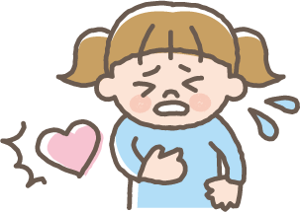
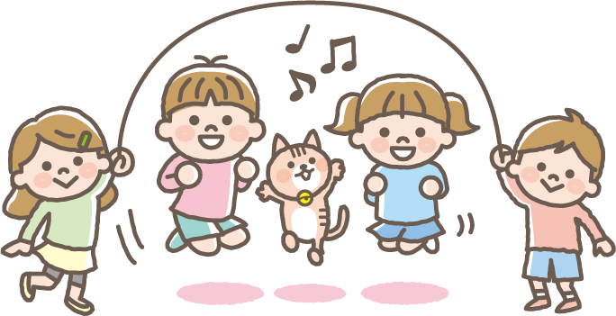
February 10, 2022
For Children Aged 5 to 11
About COVID-19 Shots
Why do people get COVID-19 shots?
When people get sick with COVID-19, this can make them sick and give them a fever, make them tired, make them cough, make it hard to breathe, give them headaches, and even make it hard to taste and smell.
If you get your shots for COVID-19, this helps your body’s insides
get ready to fight the virus and makes it harder for you to get sick
if you do get it.
Do I need to be careful when I get my COVID-19 shots?
Before
you get your shot
If you have a fever of 37.5℃ (99.5℉) or over and you don’t feel well, you can’t get a vaccine, so if you don’t feel good, make sure you let the people in your house know.
When
you get your shot
You’ll get your shot in your arm near your shoulder.
Make sure to wear a shirt with sleeves that are easy to roll up.
◎ After you get your vaccine, please sit down and wait for
15 minutes. (Some people will be asked to wait for 30 minutes)
◎After your shot, you can do what you normally do and take a bath or shower like always, but just be sure not to play outside or exercise hard after you get your shot that day.
◎Sometimes, when people get their COVID-19 shots, they might have the things listed below happen, but don’t worry, they usually go away in 2 or 3 days on their own.
After getting your shot
-Fever -Feeling icky
-Feeling tired -Bellyache
-Headache
-Chills
If you feel any of the things listed above,
make sure you let someone in your home know right away.
● Right after getting your shot
● From the day you get your shot to 4 days after
-Feeling itchy
-Coughing
-Fever -Headache -Chest pain -Trouble breathing
-Feeling tired -Chills -Feeling your heart beating fast
You’ll need to get 2 COVID-19 shots with 3 weeks in between.
Important Things to Remember
There are all sorts of people in the world.
Some people get their shots as soon as they can, and some people have reasons for not getting their shots. Don’t make fun of or bully other kids you know whether they get their shots or not.

