Slide 1

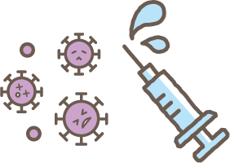

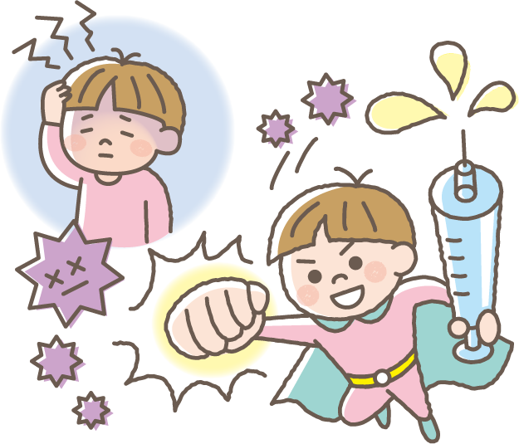
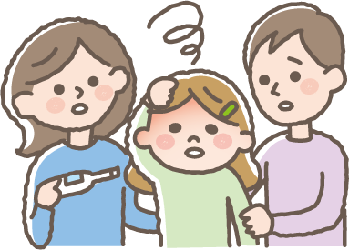
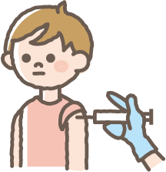

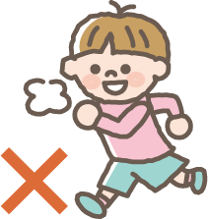
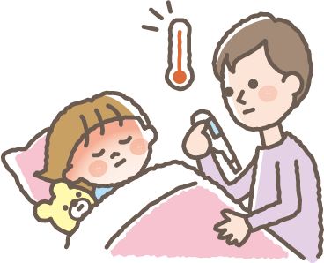
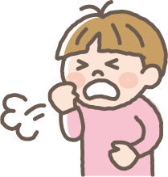
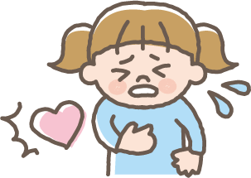

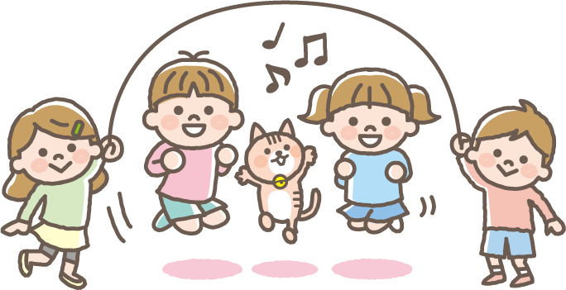
February 10, 2022
For Children Aged 5 to 11
英語
About COVID-19 Shots
Why do people get COVID-19 shots?
When people get sick with COVID-19, this can make them sick and give them a fever, make them tired, make them cough, make it hard to breathe, give them headaches, and even make it hard to taste and smell.
If you get your shots for COVID-19, this helps your body’s insides
get ready to fight the virus and makes it harder for you to get sick
if you do get it.
Do I need to be careful when I get my COVID-19 shots?
Before
you get your shot
If you have a fever of 37.5℃ (99.5℉) or over and you don’t feel well, you can’t get a vaccine, so if you don’t feel good, make sure you let the people in your house know.
When
you get your shot
You’ll get your shot in your arm near your shoulder.
Make sure to wear a shirt with sleeves that are easy to roll up.
◎ After you get your vaccine,
please sit down and wait for
15 minutes.
(Some people will be asked to wait
for 30 minutes)
◎After your shot, you can do what you normally do and take a bath or shower like always, but just be sure not to play outside or exercise hard after you get your shot that day.
◎Sometimes, when people get their COVID-19 shots, they might have the things listed below happen, but don’t worry, they usually go away in 2 or 3 days on their own.
After getting your shot
-Fever -Feeling icky
-Feeling tired -Bellyache
-Headache
-Chills
If you feel any of the things listed above,
make sure you let someone in your home know right away.
● Right after
getting your shot
● From the day you get your shot to 4 days after
-Feeling itchy
-Coughing
-Fever -Headache -Chest pain -Trouble breathing
-Feeling tired -Chills -Feeling your heart beating fast
You’ll need to get 2 COVID-19 shots with 3 weeks in between.
Important Things to Remember
There are all sorts of people in the world.
Some people get their shots as soon as they can, and some people have reasons for not getting their shots. Don’t make fun of or bully other kids you know whether they get their shots or not.

